Slide 1
Constructor Injection with Non-String Collection (having Dependent Object)
www.programmingshifts.com

Slide 2
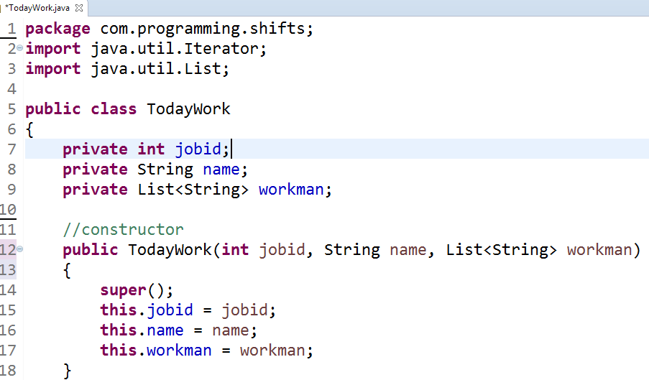
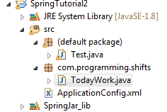
If there are dependent object in the collection, then we should inject these information by using the ref element inside the list, set or map.

Slide 3
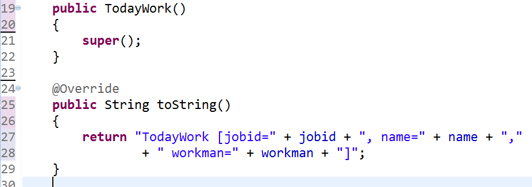


Slide 4
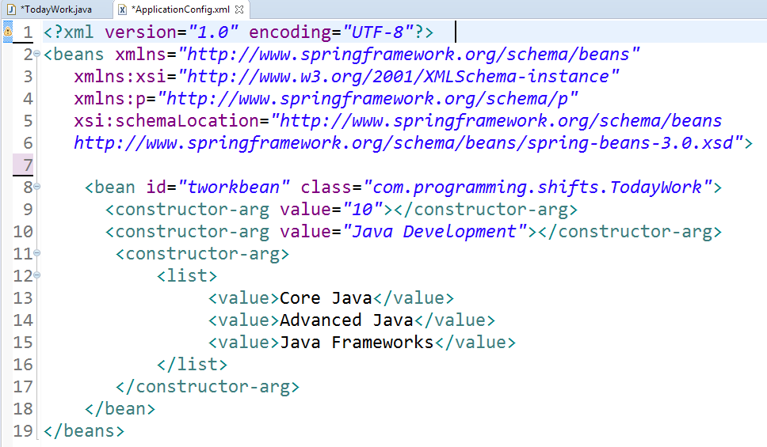
Xml context

Slide 5
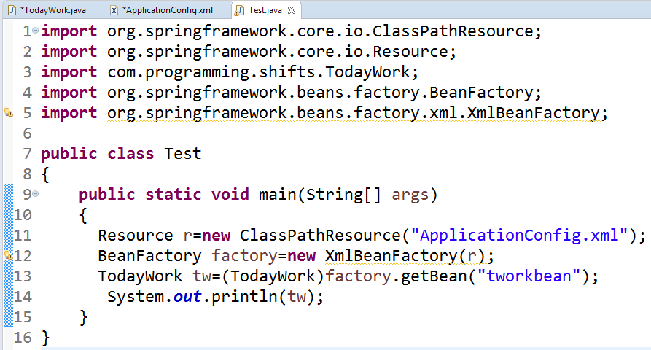

Case 1

Slide 6
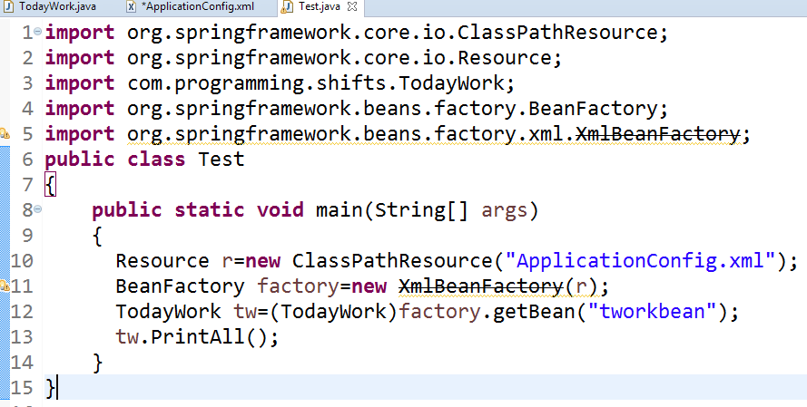

Case 2

